Slide 1
Determination of the Absolute Phase Between a Field and its Second Harmonic for use in a Coherent Control Experiment
Thesis Defense
Chris Rupley
July 20, 2004

Slide 2
Outline
Motivation for current work
Theory
Experiment and results

Slide 3
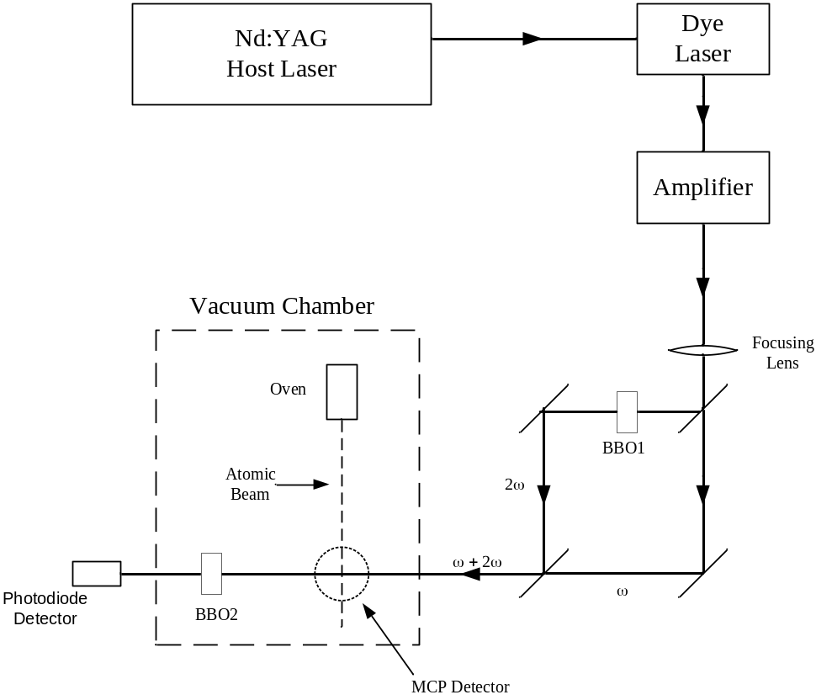

Motivation
Previous work
  Z. M. Wang Ph.D. Thesis
  Quantum Interference
Experimental setup
  Phase delay cell
  Phase Detector

Slide 4
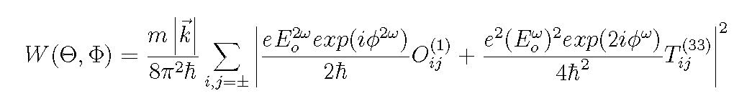
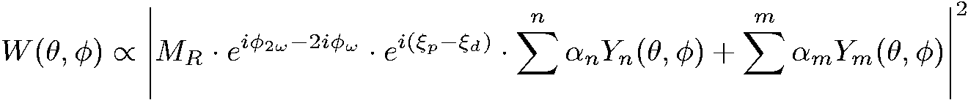

Photoelectron Angular Distribution (PAD)
Angular distribution for 2-color process
In order to determine the continuum wave phase difference,
We must know the interaction phase difference,

Slide 5
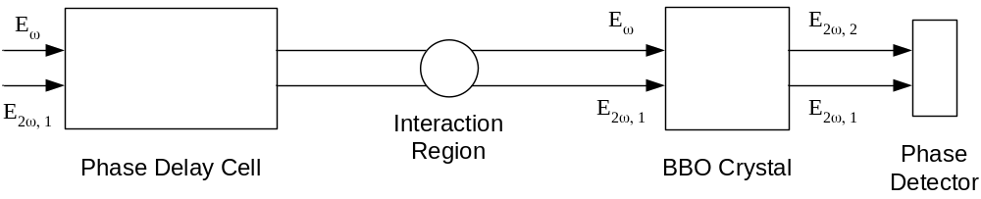
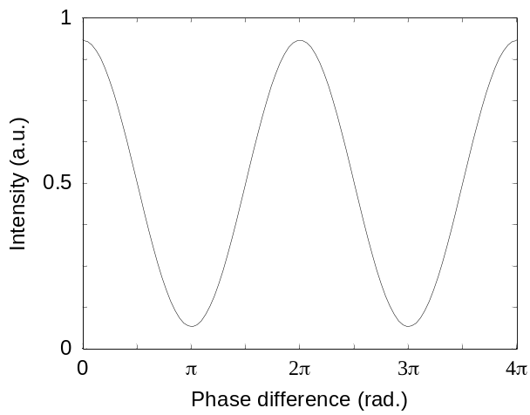
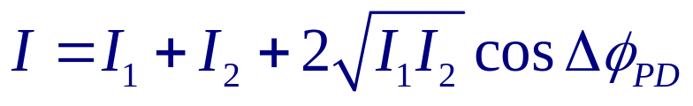
Phase Detector
Intensity of second harmonic leaving system relates to relative phase
Relative phase is varied through use of phase delay cell
Relative phase at Phase Detector is different from relative phase at interaction

Slide 6
Sources of Change in Relative Phase
Propagation
  Focused Gaussian beams
  Relative phase between different frequencies changes with propagation
Second Harmonic Generation
  Phase difference between fundamental and generated second harmonic beams

Slide 7
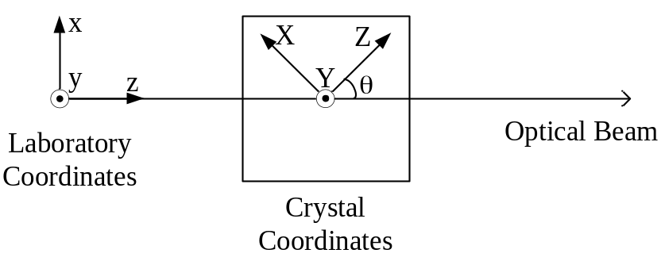
Theory
Relative phase of perpendicularly polarized fields is coordinate-dependent
Choose a coordinate system where z is propagation direction and y is up from the optical table

Slide 8
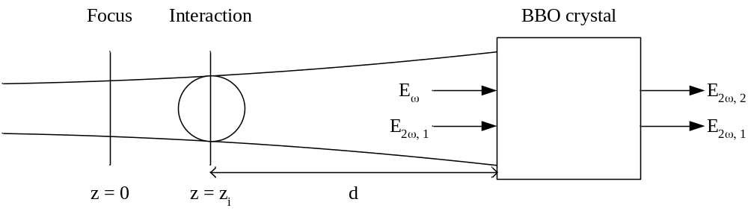

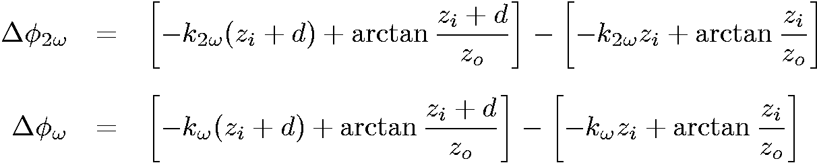
Propagation

Slide 9

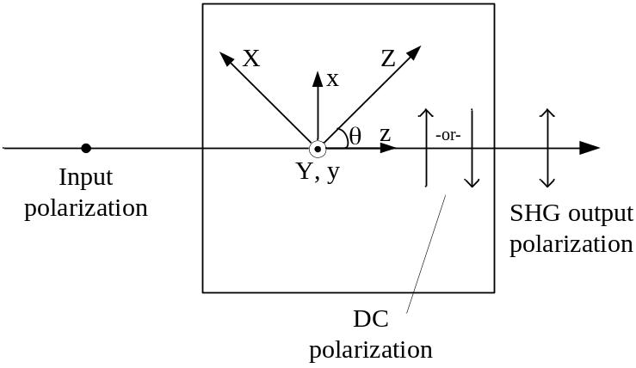


Second Harmonic Generation (SHG)
BBO crystal
  Term d_{eff} is common to SHG and optical rectification

Slide 10
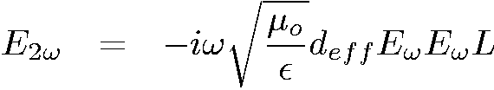
Relative Second Harmonic Phase

Slide 11
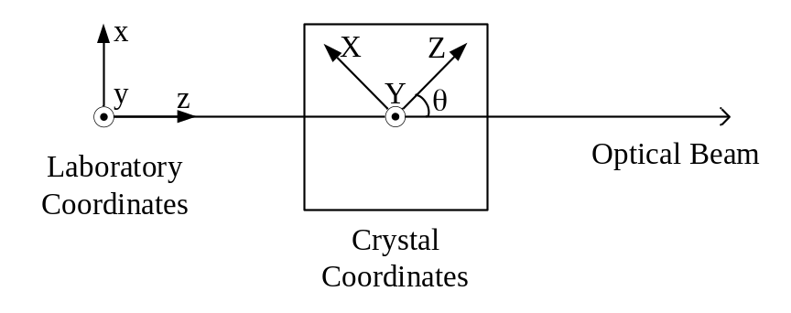
Sign of d_{eff}
φ, angle between k vector and XZ plane
θ, angle between k vector and Z axis
Sign of d_{eff} depends on relative position of crystal axes to beam propagation

Slide 12


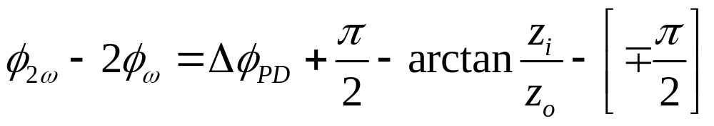

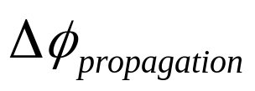
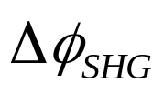
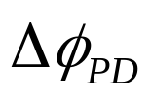


Sources of Relative Phase Difference
BBO crystal
PD

Slide 13
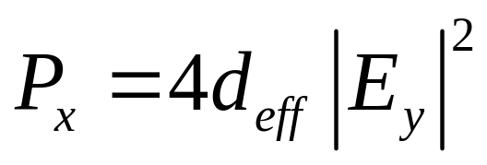
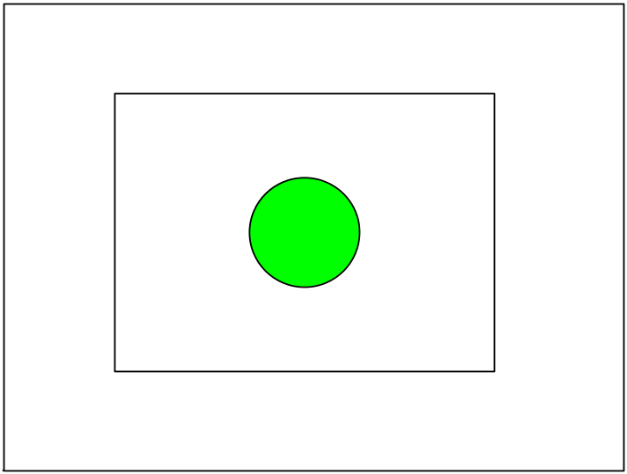
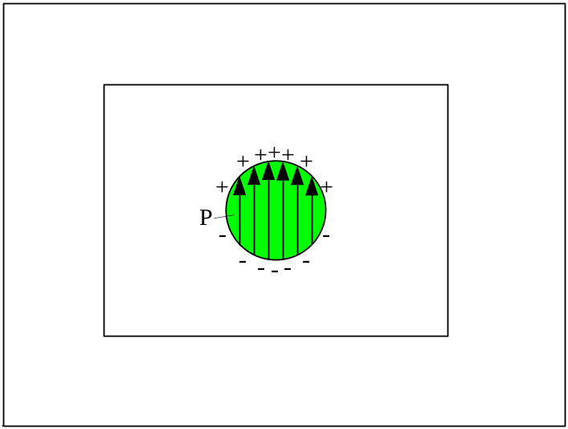


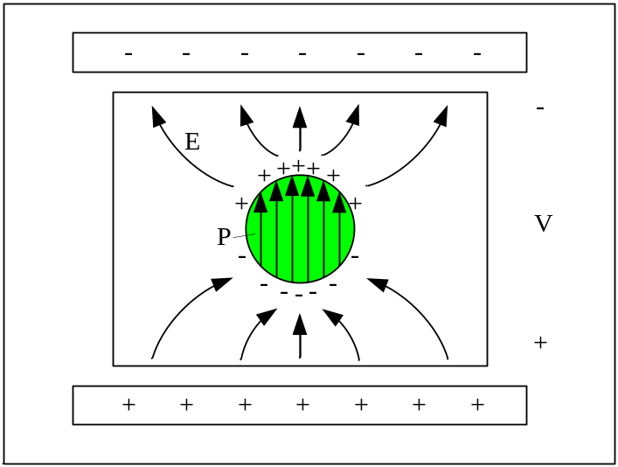
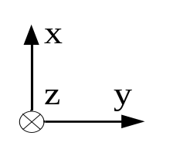
Optical Rectification (OR)
If measured P coincides with positive x-direction, d_{eff} is positive
If measured P coincides with negative x-direction, d_{eff} is negative

Slide 14
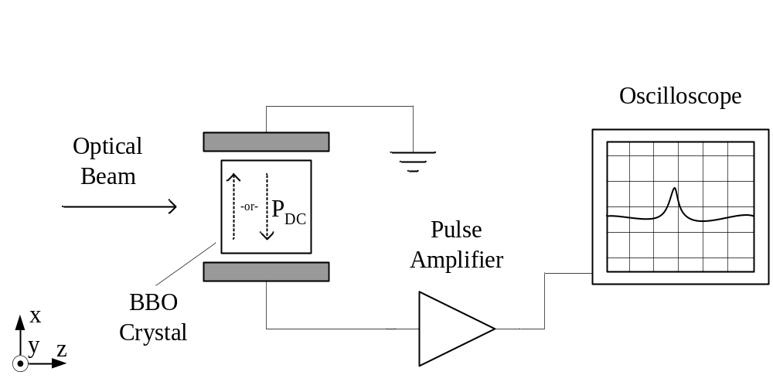
Experimental Setup
Amplifier capable of amplifying 10 ns pulse with gain of ~1000
Oscilloscope set to average over 500 pulses

Slide 15
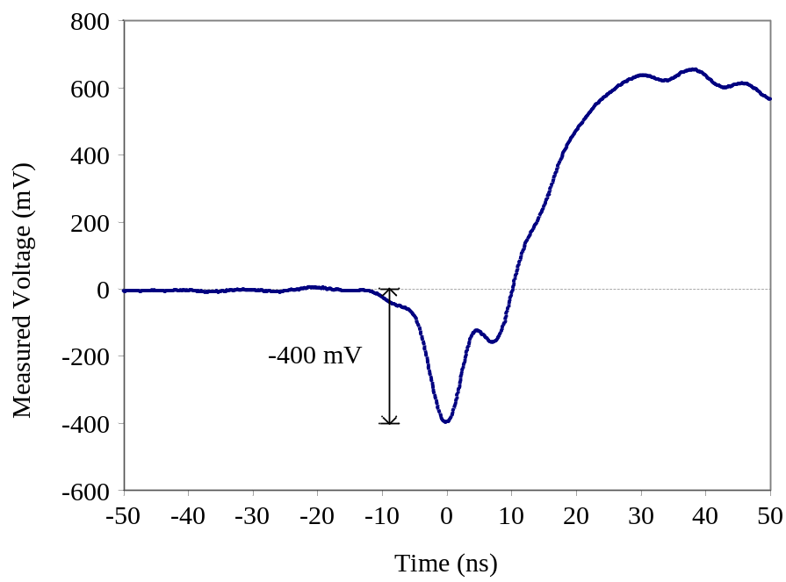
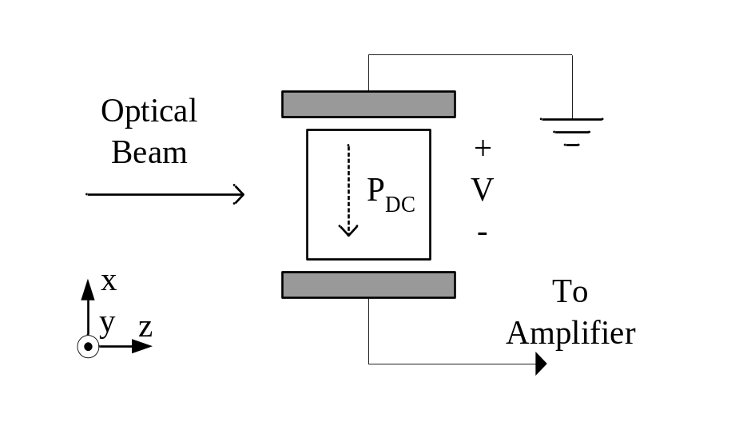

Measurement of OR
Measured Polarization in the –x direction
Indicates d_{eff} < 0 and phase shift is

Slide 16
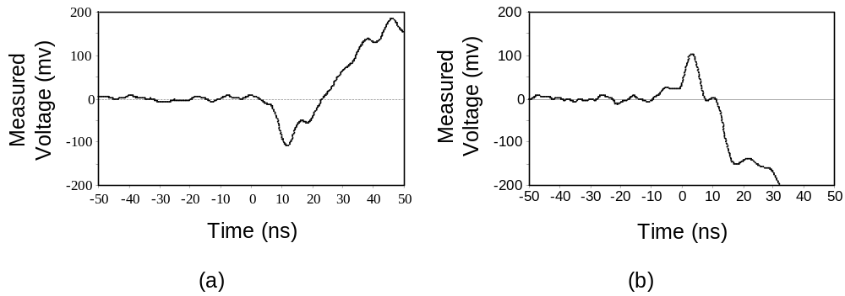
Confirmation
Crystal was rotated about the beam axis with rest of setup unchanged
Crystalline Z axis was pointing toward opposite plate
Expected change in pulse polarity was present

Slide 17


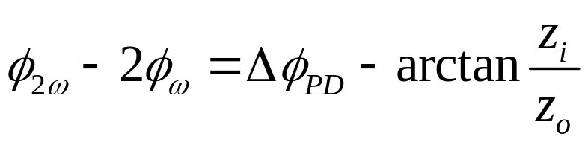
Results
For this relative orientation of crystal and beam direction, d_{eff} < 0
Shift of from propagation and
shift of from SHG cancel each other
Resulting expression for interaction phase difference:

Slide 18
Conclusion
Measurement of relative phase between a field and its second harmonic at a certain point in space
Requires knowledge of orientation of crystal axes
Orientation can be found by measuring Optical Rectification signal

Slide 19
End

Slide 20

PAD images

Slide 21
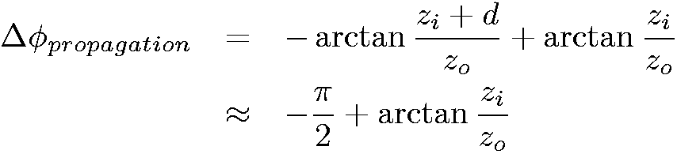
Summary

Slide 22
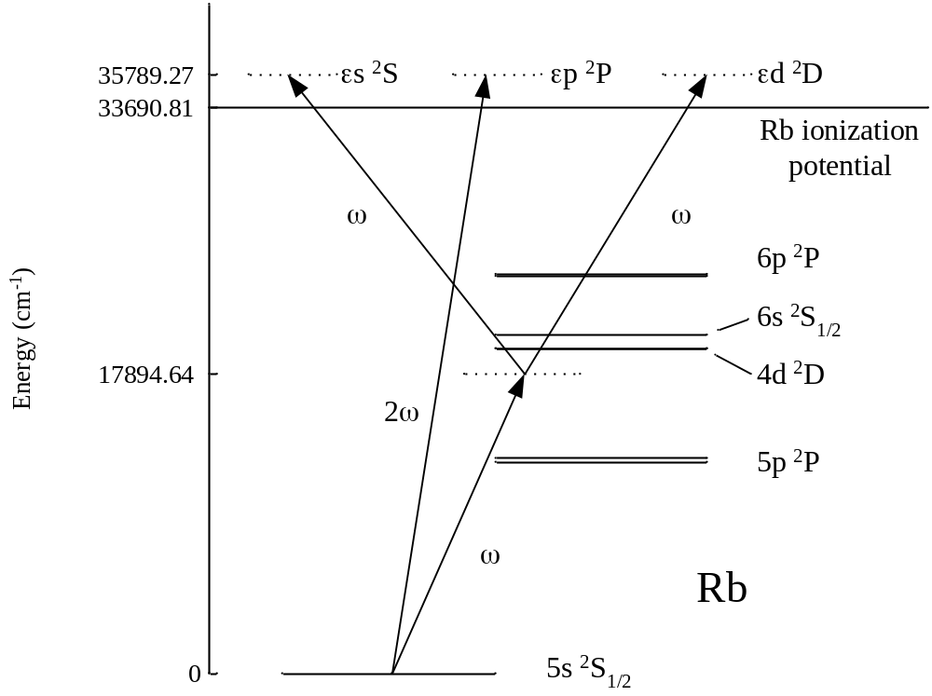
Rubidium Energy Band Diagram

Slide 23
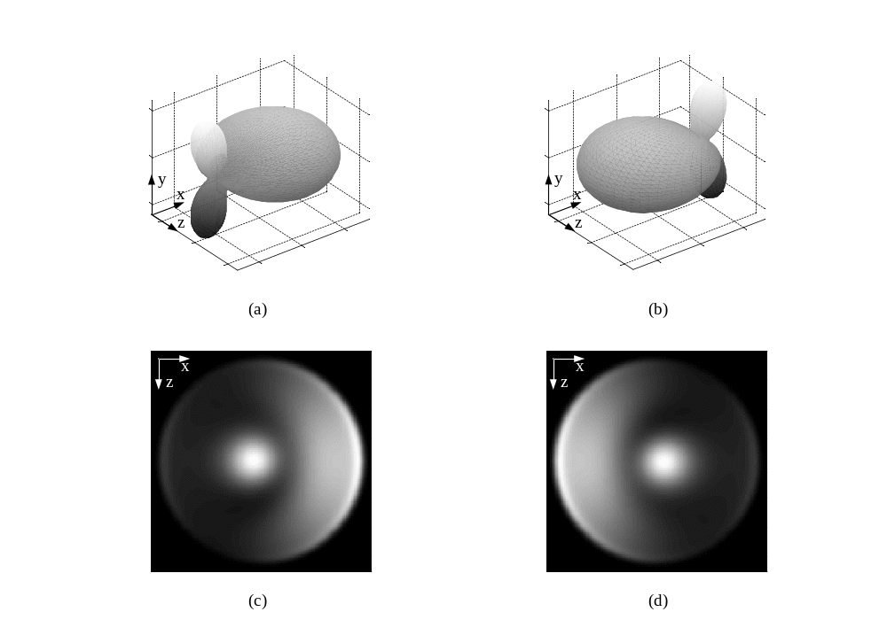
Image Flip

